Slide 1
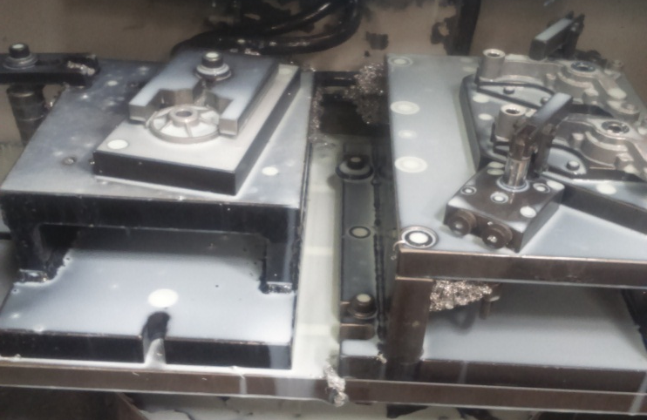
P15
KAIZEN NO :- 11
ACTIVITY
KK
QM
PM
JH
SHE
OT
DM
E&T
KAIZEN IDEA SHEET
TPM CIRCLE NAME: Achiever
LOSS NO. / STEP
DEPT :- MACHINE SHOP
RESULT AREA
P
Q
A,B,C
C
D
S
M
CELL:- Oil Pump
CELL NAME:- A410 Body
MACHINE / STAGE :- Machine No-13
OPERATION :- Machining.
KAIZEN THEME : To Improve machine Utilization .
IDEA :- :- At a time Both Small Size fixture Can Running.
Problem / Present Status :-
A410 body 2nd set up Fixture in Small Size & Can use Same Size fixture set up near this.
COUNTERMEASURE :- A410b & a173b Both Machine Fixture Loaded on One machine table.
BENCHMARK
separate set up at mac.
TARGET
All operation in MC
KAIZEN START
02.05.2017
TDC
10.05.2017
KAIZEN FINISH
04.05.2017
TEAM MEMBERS : 1) Dilip Phapale 2) Umesh Pimple,
3) Nilesh Khadke.
BENEFITS :-
Improve machine Utilization
After
KAIZEN SUSTENANCE
WHY - WHY ANALYSIS :-
Not Applicable
RESULT :-
Improve machine Utilization
Setup time Reduced.
3) Manpower Saving daily 1nos .
WHAT TO DO :- Not to Change Set Up.
HOW TO DO :- Added in Machine loading Plan.
ROOT CAUSE :- NA
REGISTRATION NO. & DATE : 10.05.2017
SCOPE & PLAN FOR HORIZONTAL DEPLOYMENT
REGISTERED BY :- Umesh Pimple
SR.
NO.
CELL
TARGET
RESPONSIBILITY
STATUS
MANAGER’S SIGN :- D. Y. Pawar
1
-
--------

